Slide 1
COMPUTER
NETWORK
TERM PROJECT
201532749 이재윤 201635817 신동재
201635840 이정명

Slide 2
Contents
Introduction
Storyline
Demo
Features &
Contents

Slide 3
Introduction

Slide 4


Main Goal
Creative
Fun
Software development to enable
confounding games between users
using TCP / IP communication
Fun game for all ages

Slide 5
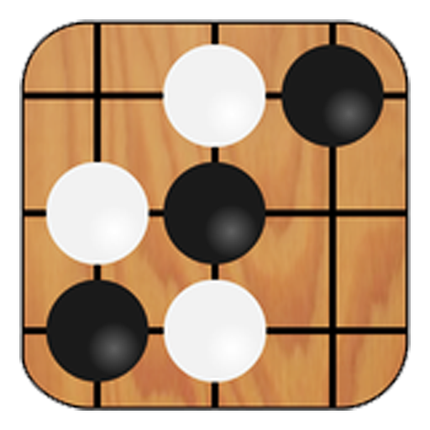

Description of Project
OUR GAME!

Slide 6
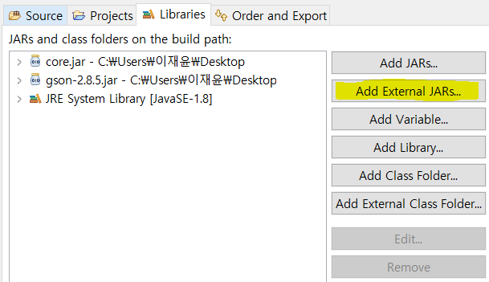
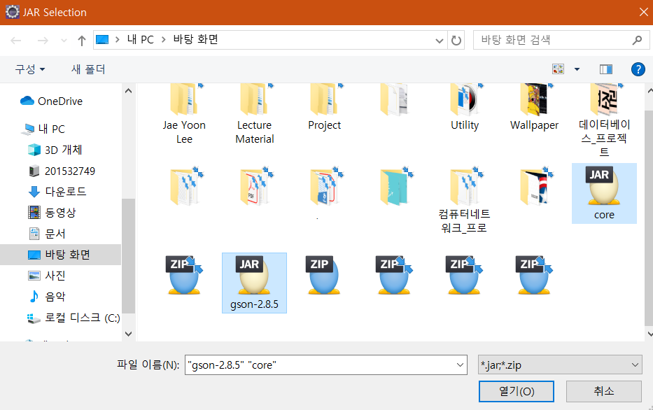
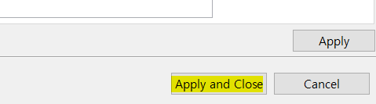
Adding External Class
STEP 1
STEP 2
STEP 3
Open ServerStart.java in server package
Add user through ClientStart.java in client package
Press the Add External Button

Slide 7
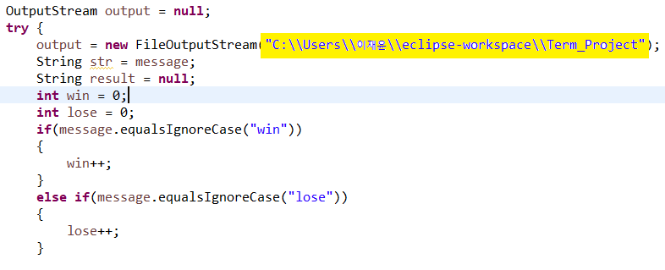
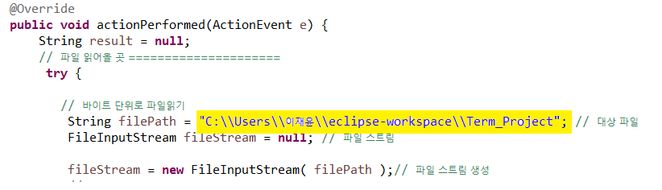
To record wins and losses
STEP 1
STEP 2
\\rank.txt””);
\\rank.txt””;
You must save the text file to the appropriate path and enter the address for the record.
You must enter the text file path in BtCountHandler.java inside the handler package.

Slide 8
Architecture
Client Server
1. Connect
Server Start
2. Client start
Client UI
2. Server start
thread
Client UI
Client Network
4. request/response
protocol communication
Personal Server
3. UI create ClientNetwork
and show login Panel
Method
sendStateRoom
sendUserList
sendLoginRequest
Receive
Loading
. . .
User Account
Pool
Method
Create
Join
Logout
Get
Creatroom
. . .
Handler
Account
Panel

Slide 9
Storyline

Slide 10
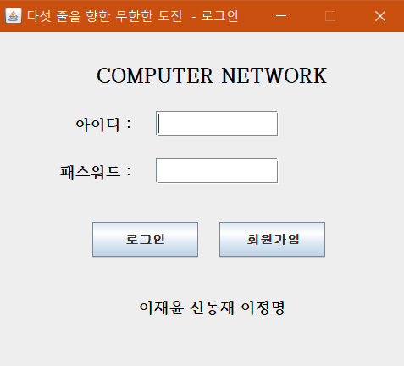
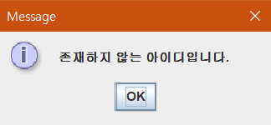
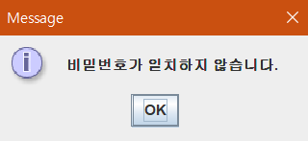
Login
If there is a duplicate ID
If the passwords do not match

Slide 11
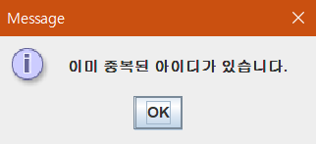
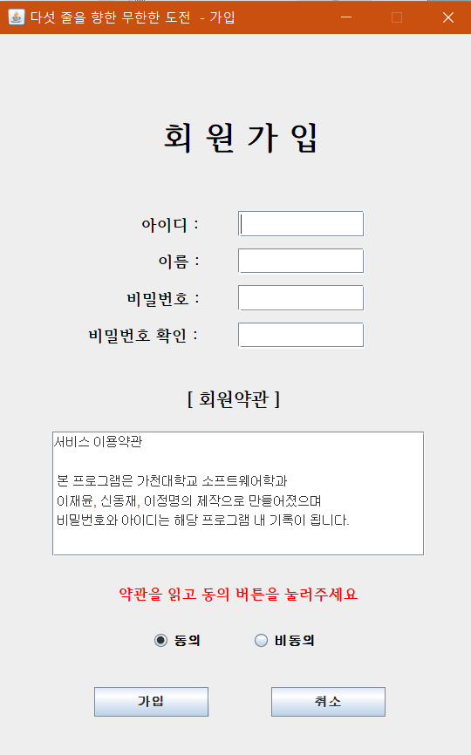
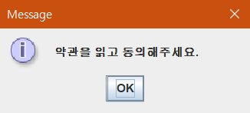
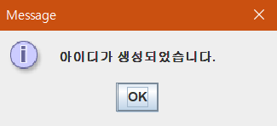
Sign up
If there is a duplicate ID
If the passwords do not match
If you do not press the
Agree button
After ID created

Slide 12
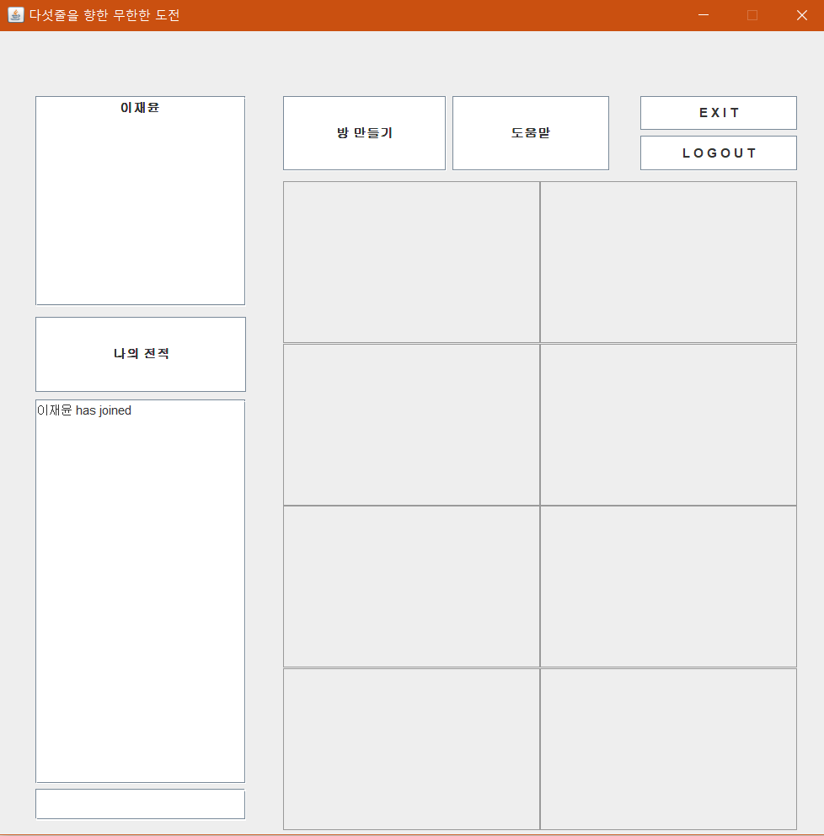
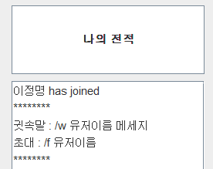
Waiting Room
List of User
Game Room
Display help only to the user who clicked when the help was pressed
Win/Loss record
Chatting Room

Slide 13
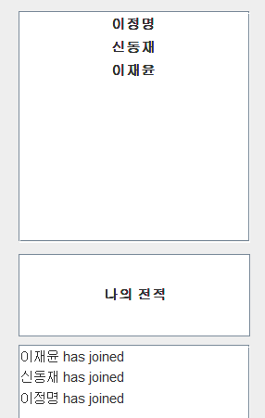
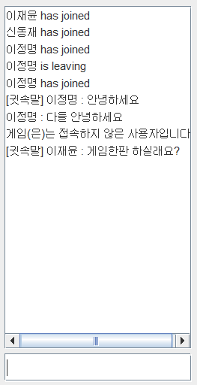
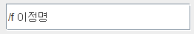
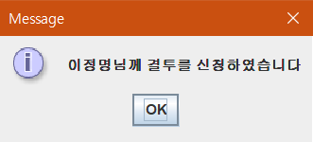
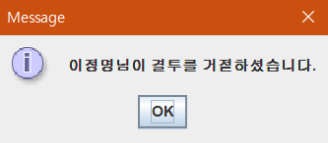
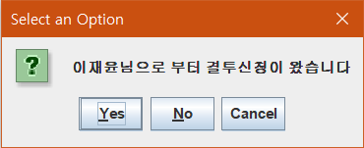
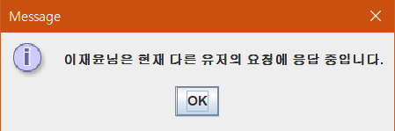
Waiting Room
이재윤 invite to 이정명
When the user connected
When the user leave
When the user whispered
이재윤’s notification window
When the user chatted
When 이정명 declined the invitation
이정명’s notification window
When you invite another user who has already been invited

Slide 14
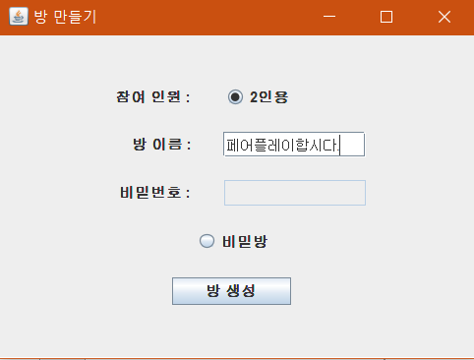
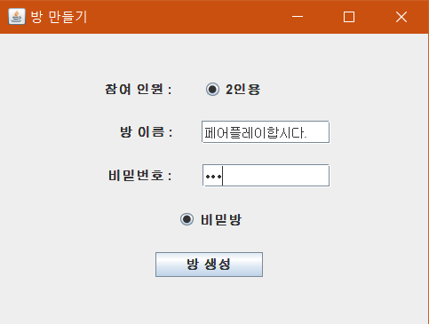
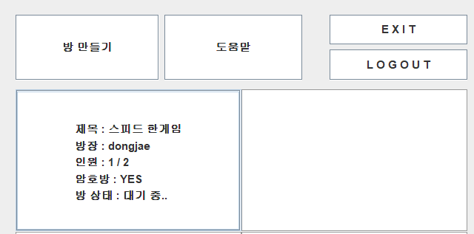
Creating Room
Creating normal room
Creating secret room
After creating room

Slide 15
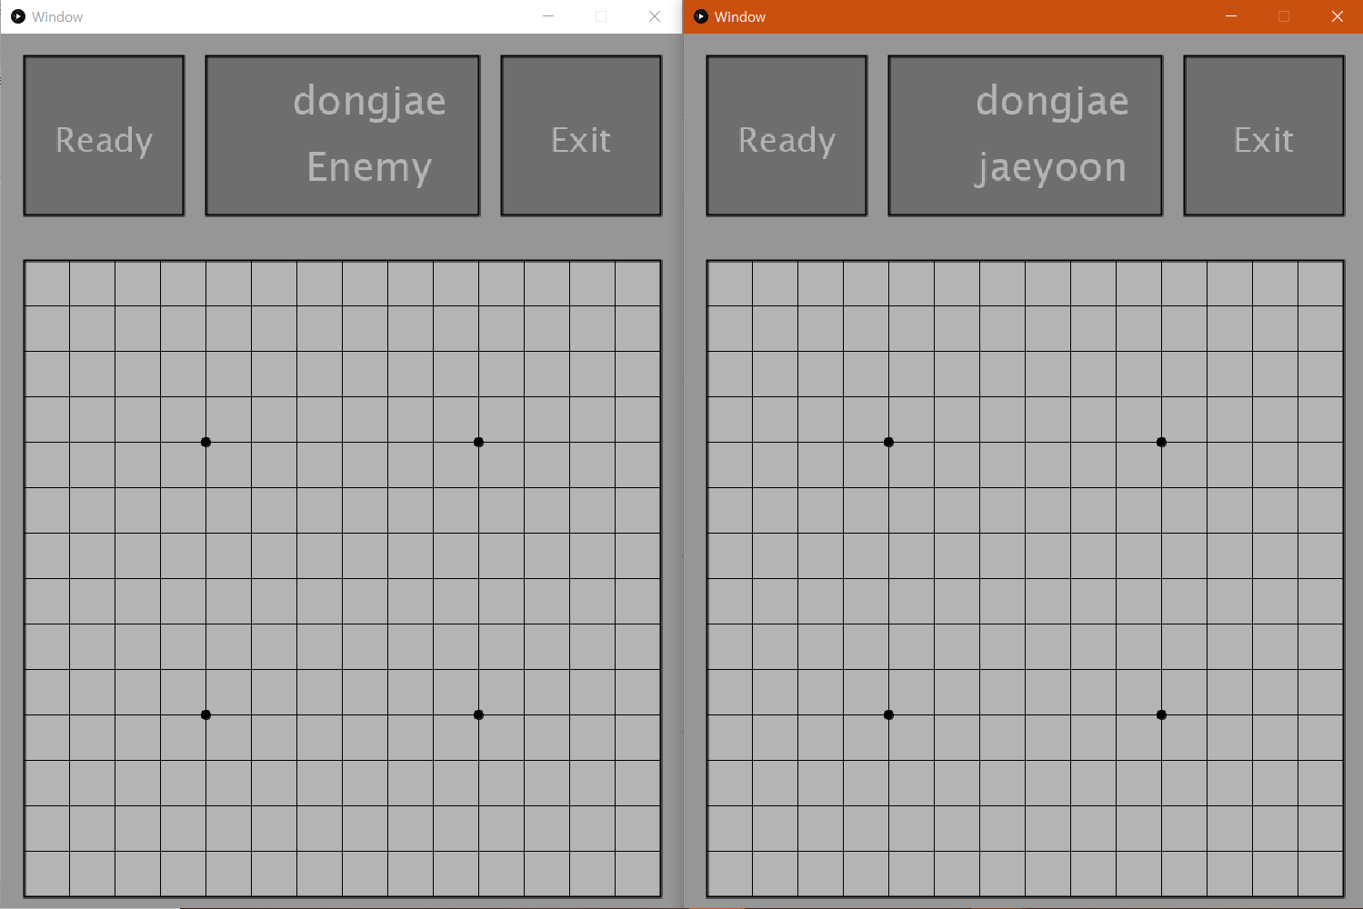
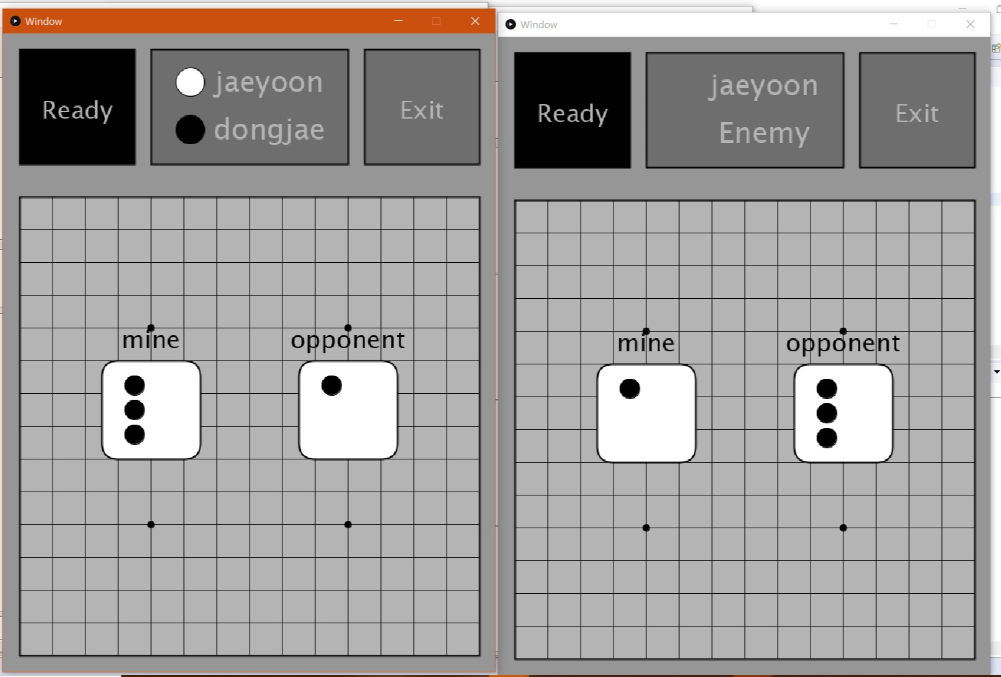
Game Screen
Game initial
setting screen
Throw the dice and add
black stone white stone

Slide 16
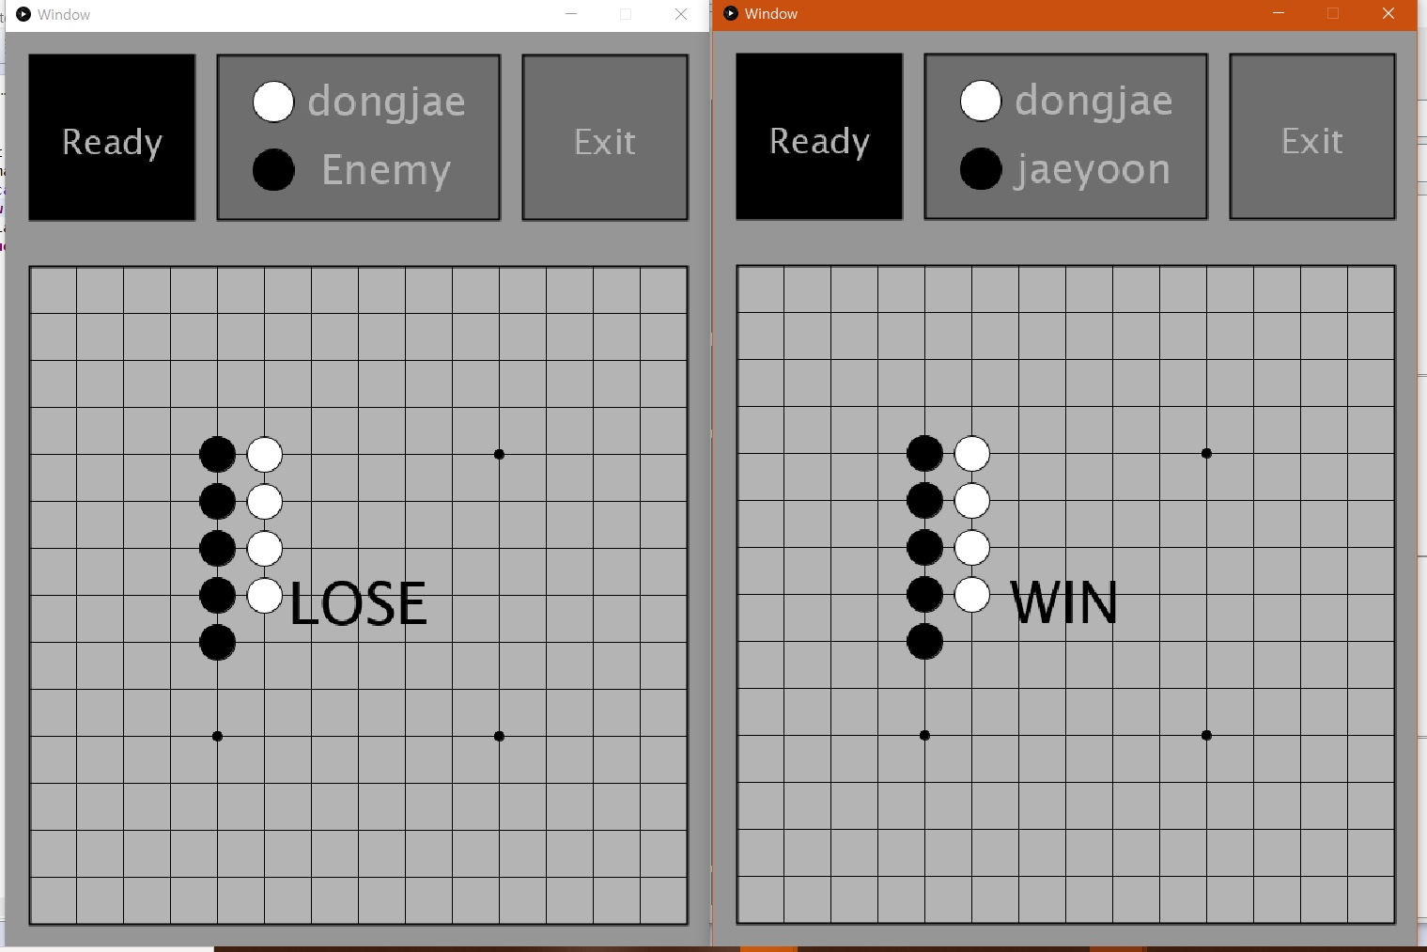
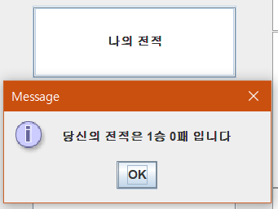
End Game
Once the outcome of the win or loss is determined
confirm the record

Slide 17
Demo

Slide 18
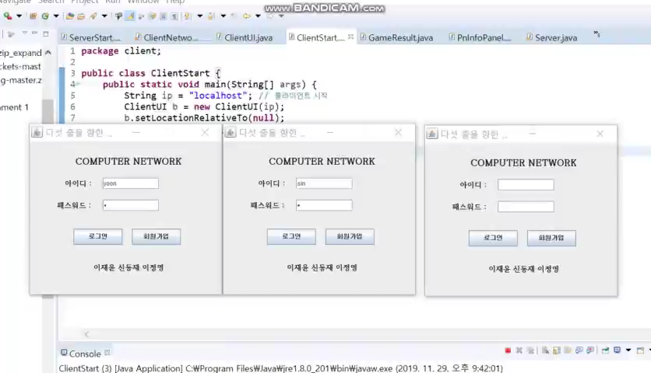
Login & Waiting room

Slide 19
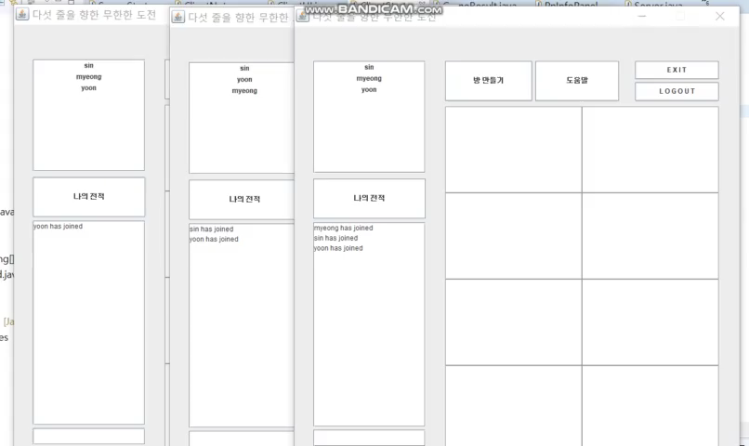
Create room & Gameplay

Slide 20
Features
&
Contents

Slide 21

Differentiation
Invite & whisper
function
Easy to use in the waiting window
with the specified protocol.
UI
UI is very clean.
Create Room
function
In addition to the confrontation
function, you can create a room
and play the game.

Slide 22
Main Technology
Game Invitation | Chat Service | Room Creation
JAVA swing | socket programming for multi-thread | 2 person version, Password room can be created
protocol processing /f invite | protocol processing /w whisper

Slide 23
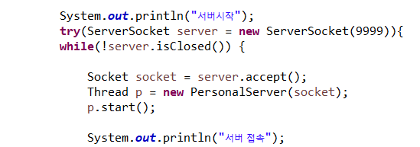
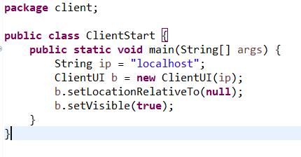
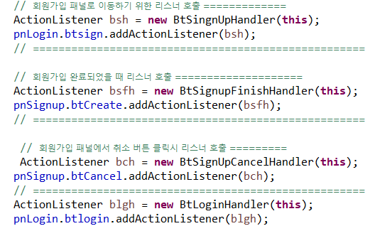
Main Code
Starting Server
Starting Client
Action handler
Open the game's server and receive the client.
It must be executed essentially for the client to connectthe client to connect.
UI that detects when client takes action and sends
it to server.

Slide 24
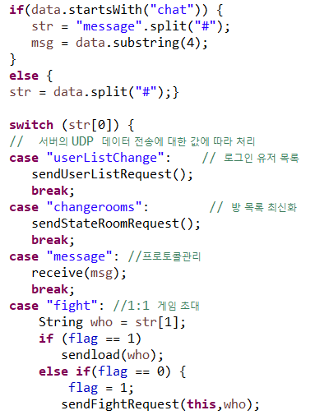
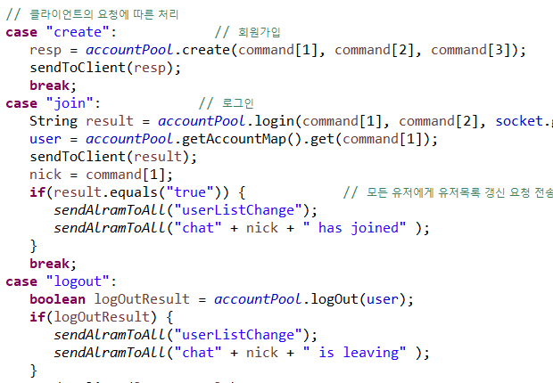
Main Code
Command processing of the client
Processing requests from clients on the server

Slide 25
Improve Way
I think it would be good to upgrade UI a little bit more.
It may be better to manage data more systematically through Database linkage.

Slide 26

Thank you

